Slide 1


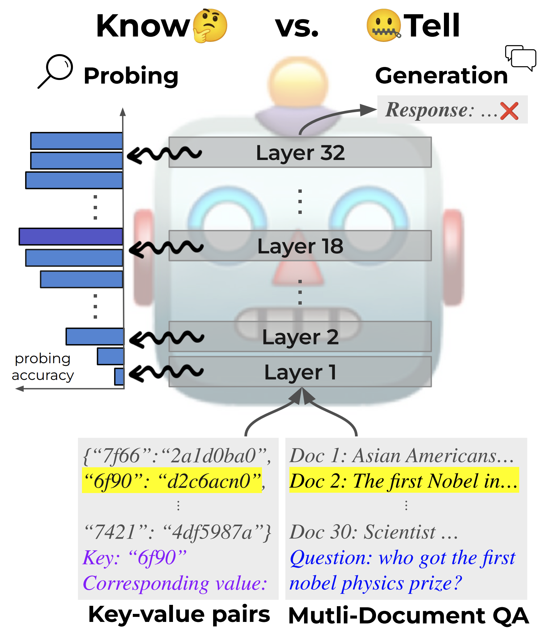
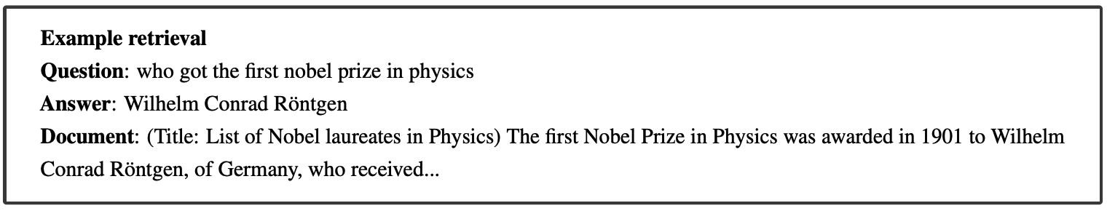
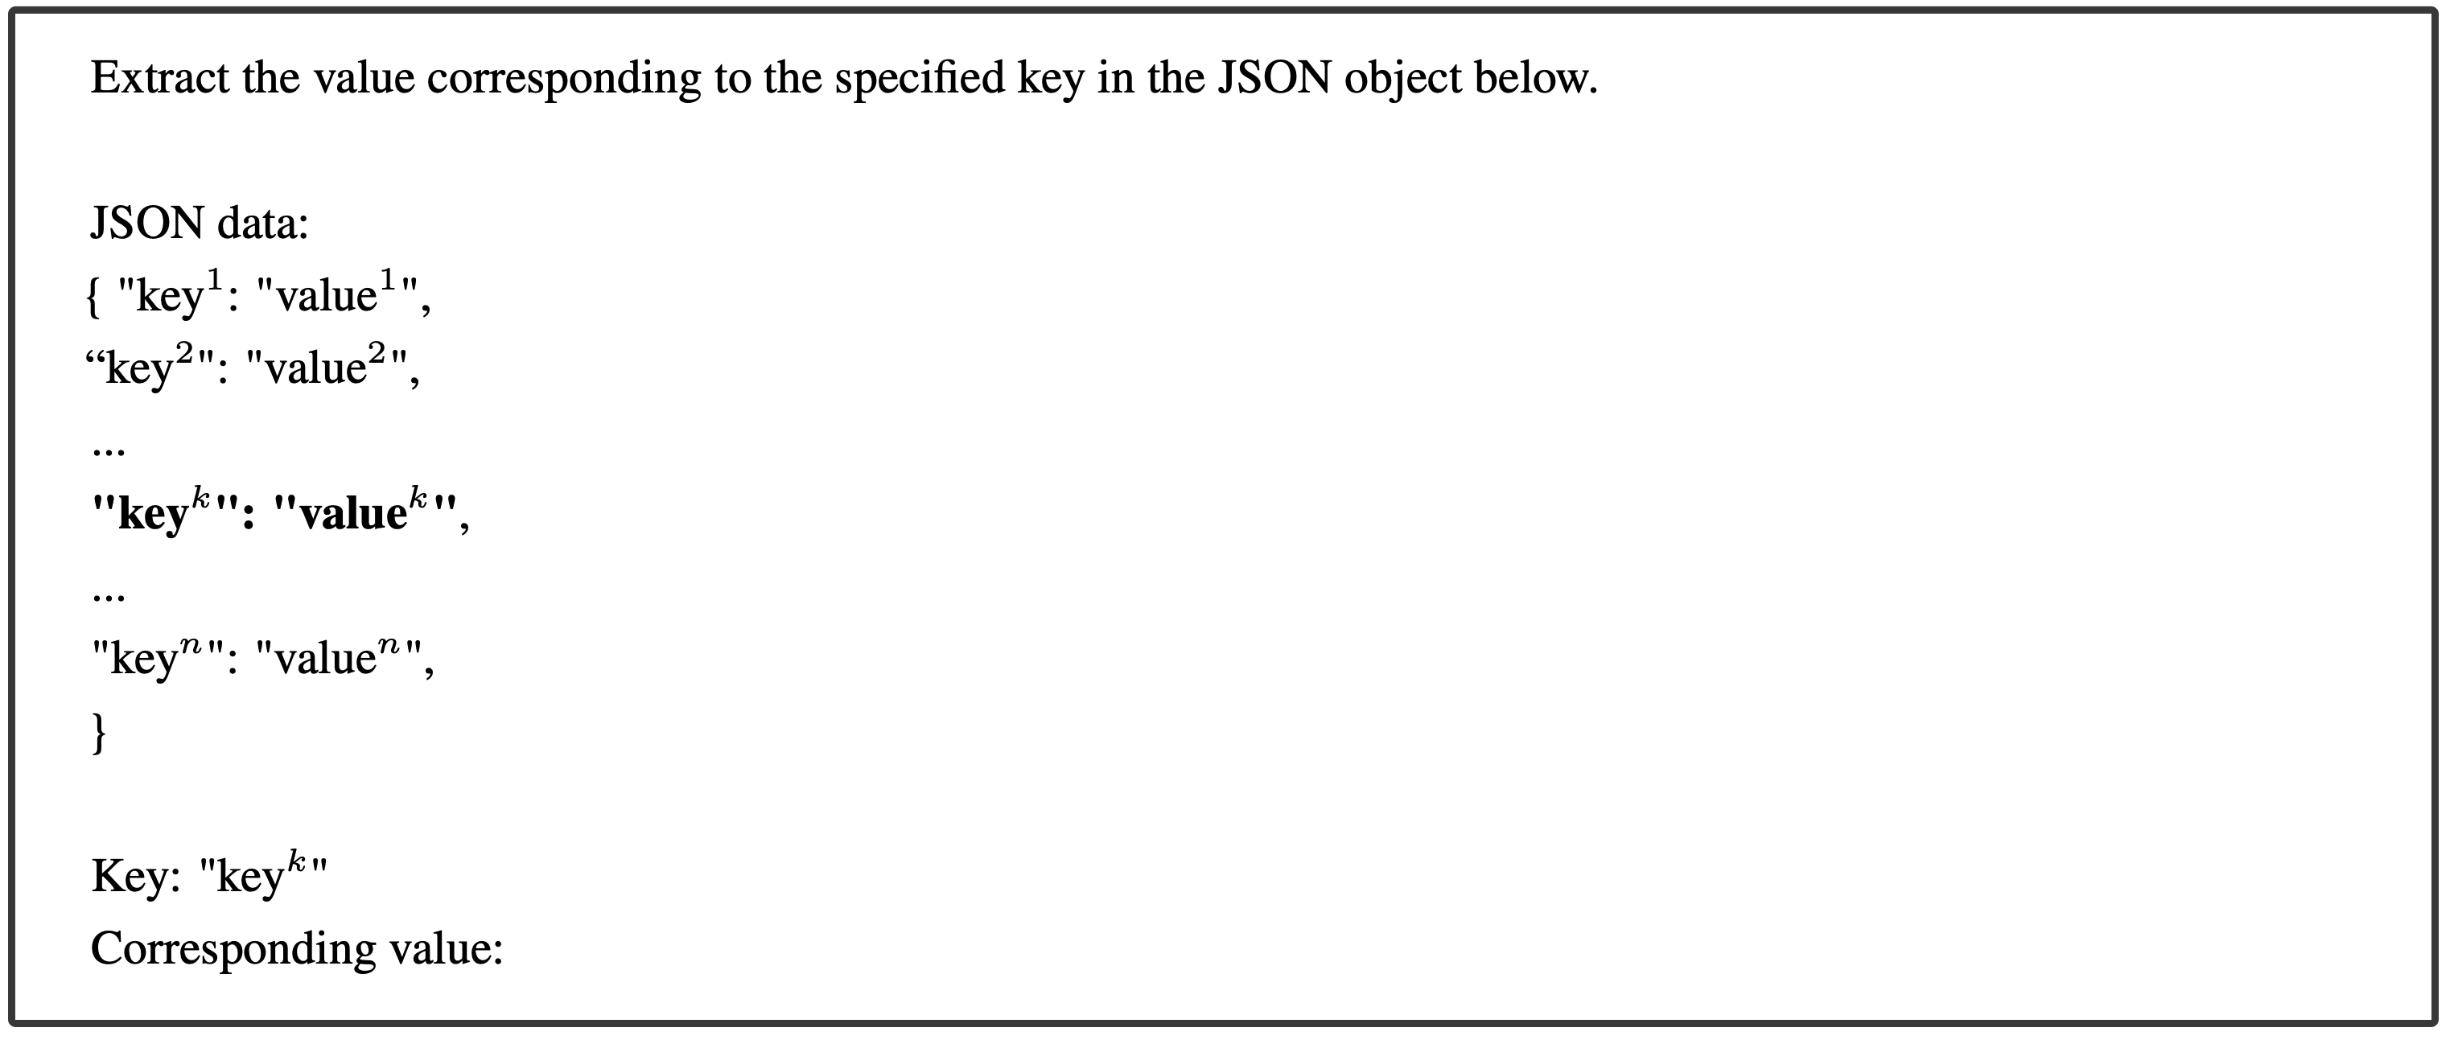
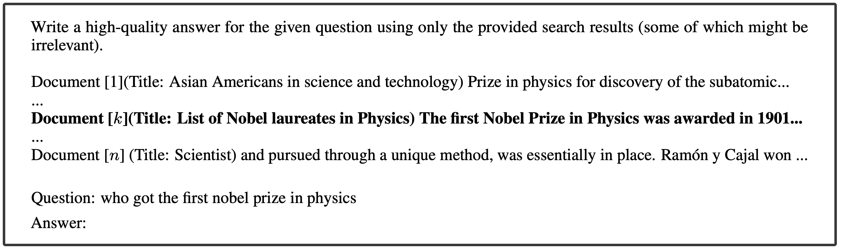
Insights into LLM Long-Context Failures:
When Transformers Know but Don’t Tell
Muhan Gao*, Taiming Lu*, Kuai Yu*, Adam Byerly, Daniel Khashabi
Johns Hopkins University | Whiting School of Engineering | Baltimore, MD
Introduction
Results
Large Language Models (LLMs) face challenges in using information from long contexts due to positional biases. Our study investigates how well LLMs encode and use positional information from various positions in long inputs. Although the models internally capture relevant information, they often fail to apply it effectively when generating responses, demonstrating a "know but don’t tell" behavior. Our work probes the model’s hidden layers to assess the encoding of crucial information, uncovering gaps between what the models know and what they can express.
(a) LLaMa3-8B-Instruct
Objectives
Positional bias affects model performance, such as a drop in accuracy for information presented in the middle of long texts.
Despite various efforts to address these biases, the underlying mechanisms remain unclear, necessitating a deeper investigation into the internal workings of LLMs.
We aim to use probing classifiers to measure how well positional information is encoded and determine why the model struggles to utilize it.
(b) Mistral-7B-Instruct-v0.3
Figure 2: Accuracy of LLMs in directly generating answers (blue line) compared to the maximum probing accuracy across layers by our probing classifiers (red line)
Materials and Methods
Peak Probing Accuracy:
Probing classifiers achieved higher accuracy than the models' direct generation.
Indicates LLMs know where the critical information is located but fail to use it effectively.
Model Selection:
Experiments were conducted on state-of-the-art models like LLaMa3-8B-Instruct and Mistral-7B-Instruct-v0.3. Embeddings were collected from different layers, and accuracy was measured using probing classifiers.
Dataset:
Key-Value Pairs Retrieval (kv-pairs) comprises multiple key-value pairs formatted in a JSON object. Each key is a 128-bit randomly generated UUID, and the corresponding value is unique.
Multi-Document Question Answering (MDQA) includes prompts where the model must answer a question using information from a set of documents, only one of which contains the correct answer (the "gold" document).
(a) LLaMa3-8B-Instruct
Tasks:
Key-Value Pair Retrieval: Identifying values given specific keys from a list.
Multi-Document Question Answering: Finding the correct document containing the answer to a question among multiple distractors.
Prompts:
(b) Mistral-7B-Instruct-v0.3
The n kv-pairs are composed into one single JSON object. To test at ID k, we choose one pair as gold, insert it at ID k, and then construct as a prompt in the format:
Figure 3. The probing accuracy for each layer in the two tasks: kv-pairs (left) and MDQA (right)
Layer Analysis:
Information retrieval accuracy improved through deeper layers, especially for details located in the middle of inputs.
However, this accuracy often decreased after peaking, indicating inefficiencies in information utilization for mid-context information.
Impact of Positioning:
The relationship between the peak probing accuracy layer and the accuracy of LLMs in generating the correct answer shows a negative correlation.
The findings show that earlier retrieval of key information correlates with better generation accuracy.
For MDQA, we sample n − 1 distractors, relevant documents that do not contain the answer. To test at ID k, we randomly shuffle the distractors and then insert the gold document at ID k. Example prompt with gold document at ID k is like:
Conclusion
Probing:
A linear regression model to assess the "quality" of each layer's representation to capture the context of long inputs
For each layer, we train a linear regression with the embedding above as input features and index k as label.
We then check each layer's accuracy evaluate its performance at each index.
LLMs know where the critical information is located but fail to use it effectively.
Retrieval of mid-context information required deeper layers, and accuracy often declined after reaching the peak.
When an LLM encodes information from a specific index earlier, the final output accuracy for that position increases.

